Slide 1
Common Random Numbers in Discrete Event Simulation for Disease Modeling:
A Statin Treatment Case Study
Hanxuan Yu¹, hanxuan.a.yu@vumc.org
John Graves¹, Shawn Garbett², Ashley A. Leech¹, Jinyi Zhu¹
¹Department of Health Policy, Vanderbilt University School of Medicine, Nashville, TN
²Department of Biostatistics, Vanderbilt University School of Medicine, Nashville, TN
Notes:
Hi everyone, I’m Hanxuan Yu from Vanderbilt University Department of Health Policy, and I’m applying for Phd in the decision science track for Fall 2024.

Slide 2
No conflicts of interest
Notes:
This project has no conflicts of interest declared.

Slide 3
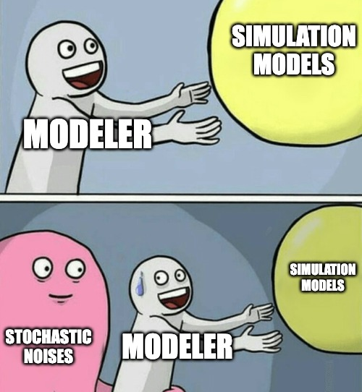
Common Random Numbers(CRNs)
Notes:
This project has no conflicts of interest declared.

Slide 4
Common Random Numbers(CRNs)
To reduce the stochastic noises between simulation iterations
“CRN is the coordinated or synchronized use of random numbers such that the same random numbers are ‘common’ to the same stochastic events across all model runs.”(Stout & Goldie, 2008)
Already been applied in micro-simulation, but under-explored in discrete event simulation for disease modeling
Notes:
The stochastic noises are always annoying for us when we build simulation models. However, common random numbers are here to help! For the definition, it is the coordinated use of random numbers that we are applying the same random number for the same event among all the runs. For disease modeling, this technique has been applied in microsimulation, but it is under-explored in discrete event simulation.

Slide 5
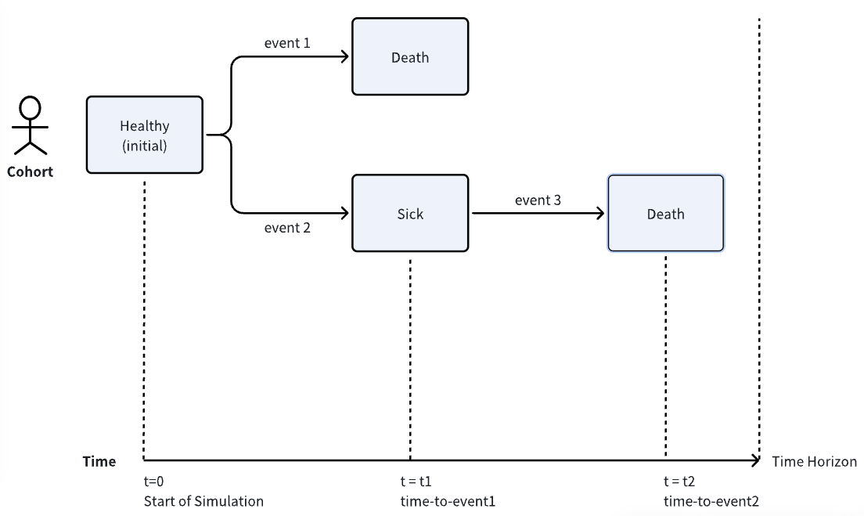
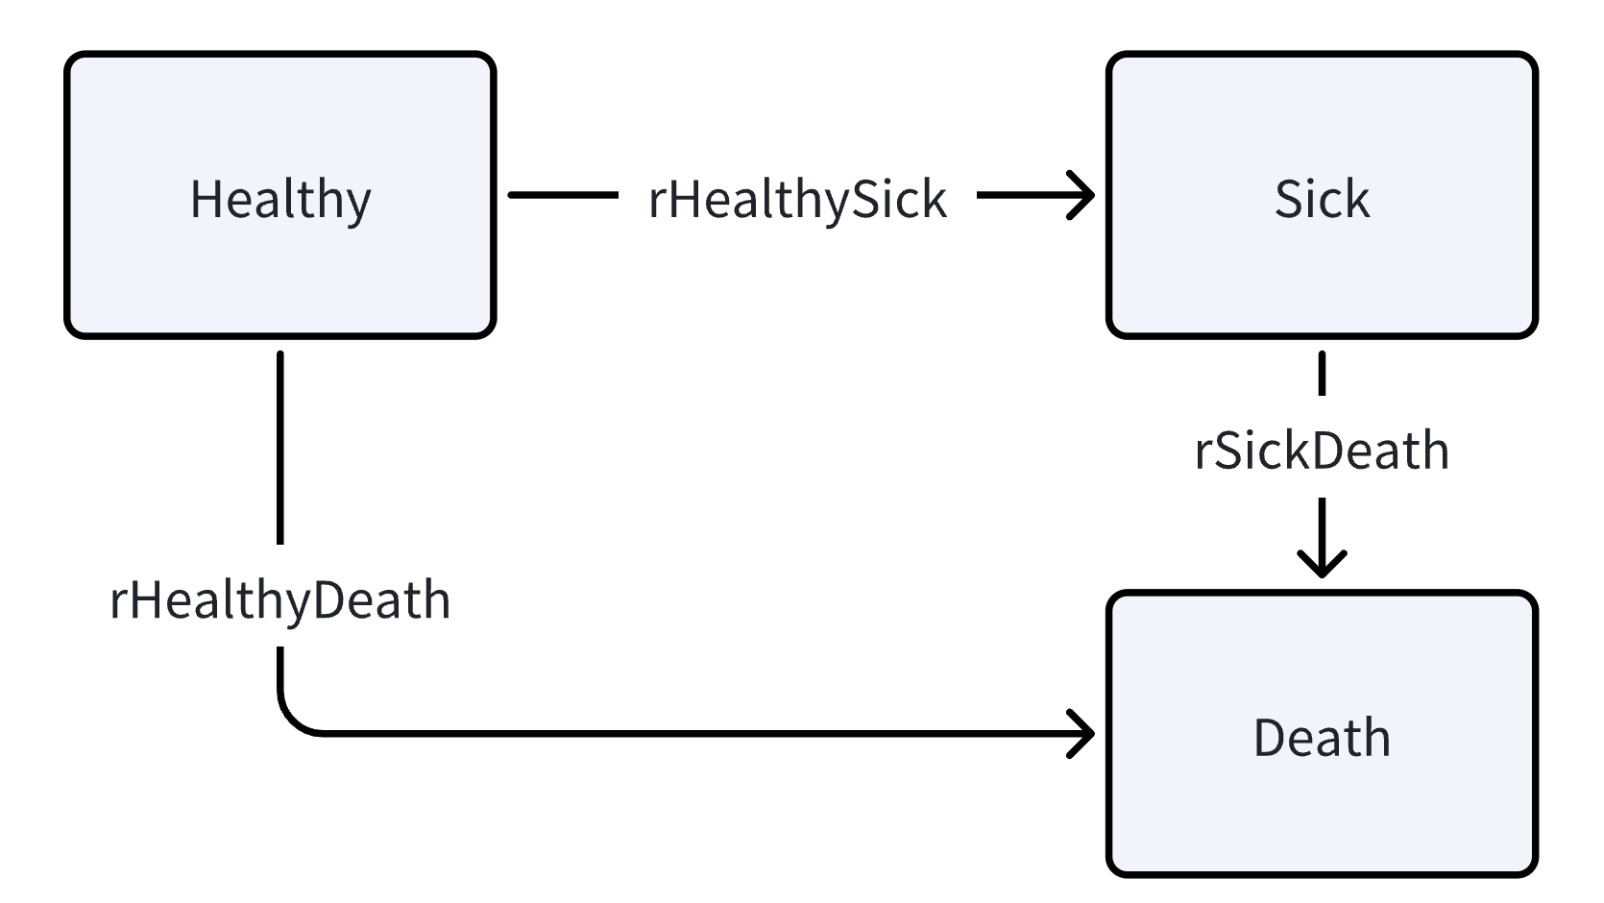
Discrete Event Simulation(DES)
RN t_BGdeath
RN t_sick
RN t_sickdeath
A simple DES model
Notes:
To know how to use random numbers in discrete event simulation, we give a simple Healthy-Sick-Death DES model here. A person can die of background mortality, for example, a car accident, or get sick and die of the disease. We will generate the random numbers for the time to background death, the time to get sick, and the time to die of the disease after getting sick.

Slide 6
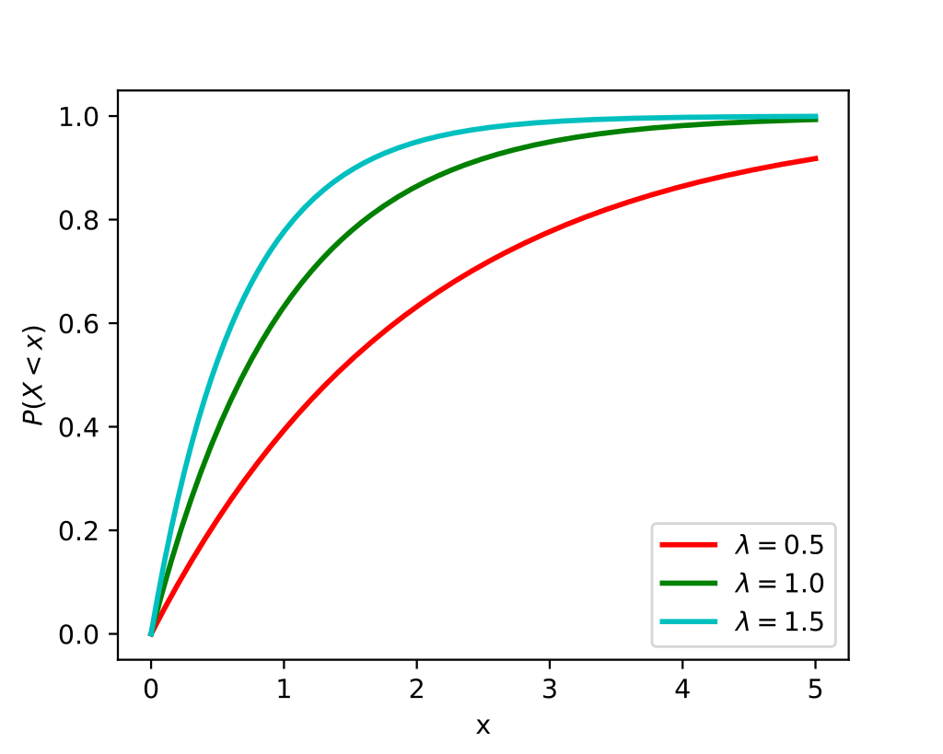
Sampling time-to-event variables
Inverse transform sampling
Generate a uniform random number u in (0,1)
u is the quantile in the cumulative distribution function (CDF)
Plug u into the inverse CDF to get the corresponding time t
u
t1
t2
t3
t
Notes:
When it goes to the way to sample the time, we use inverse transform sampling for cumulative distribution. First we generate a random number between 0 and 1 from a uniform distribution, which will work as a quantile, and then put u into the cumulative distribution function to get the corresponding time t. For the same u, distributions with different rates will produce different

Slide 7
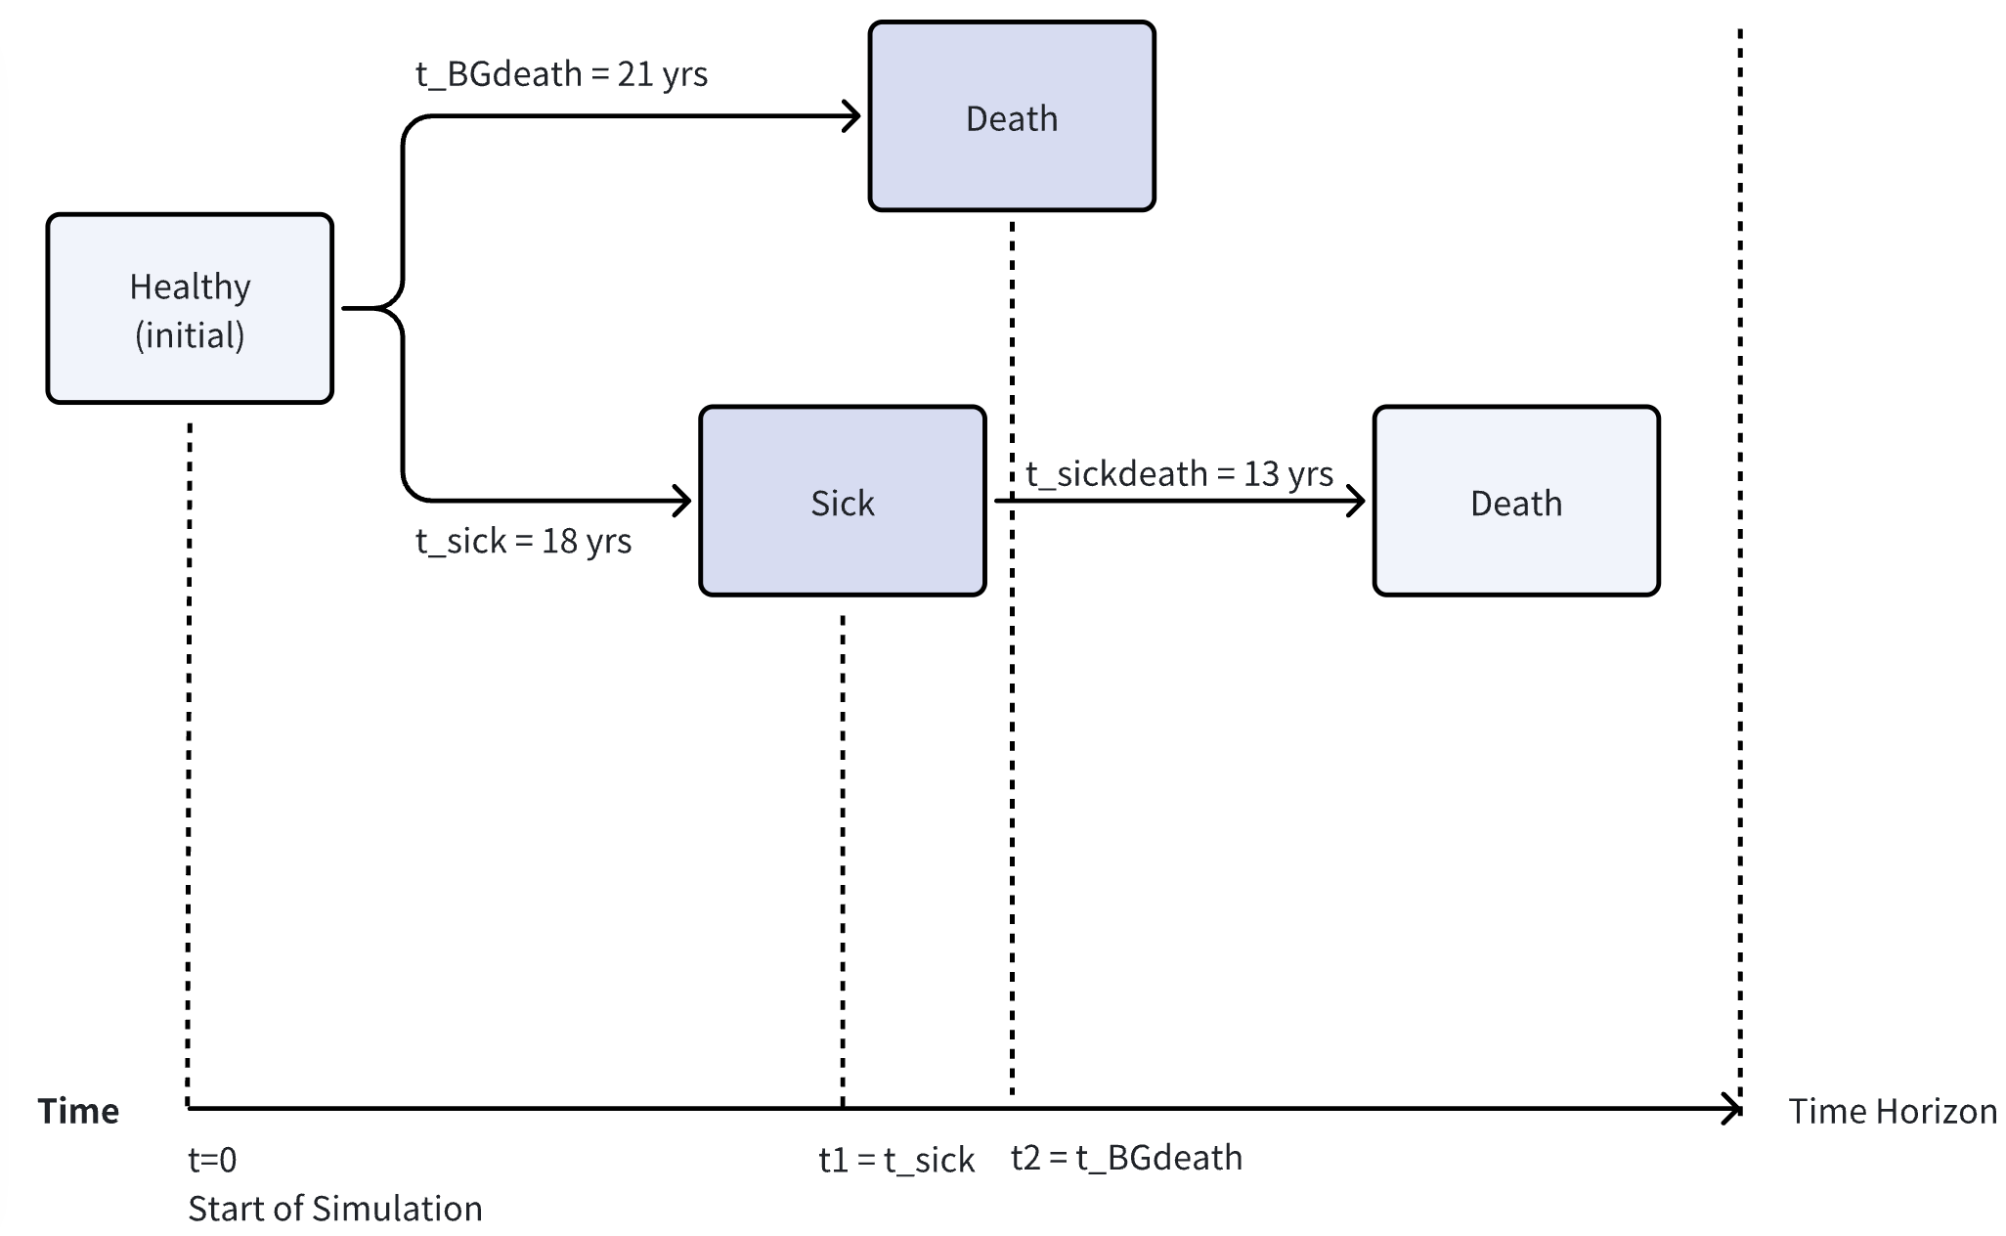
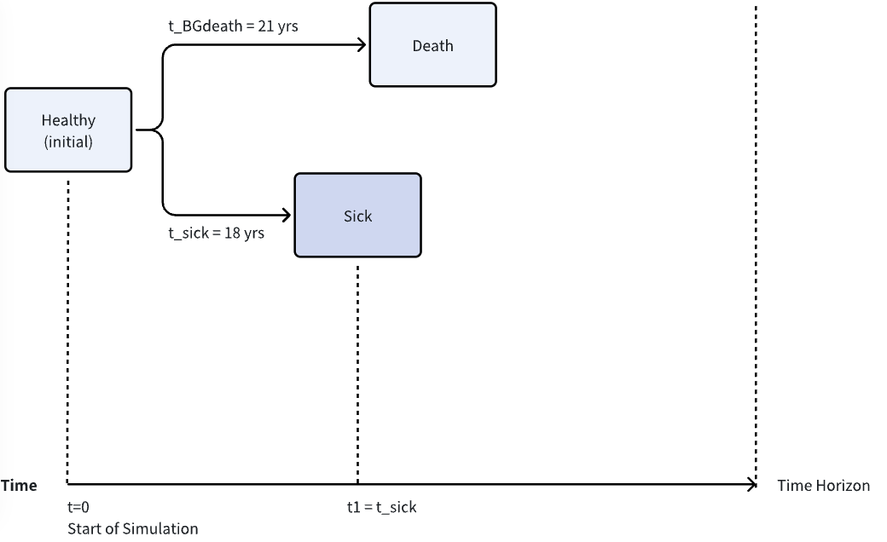
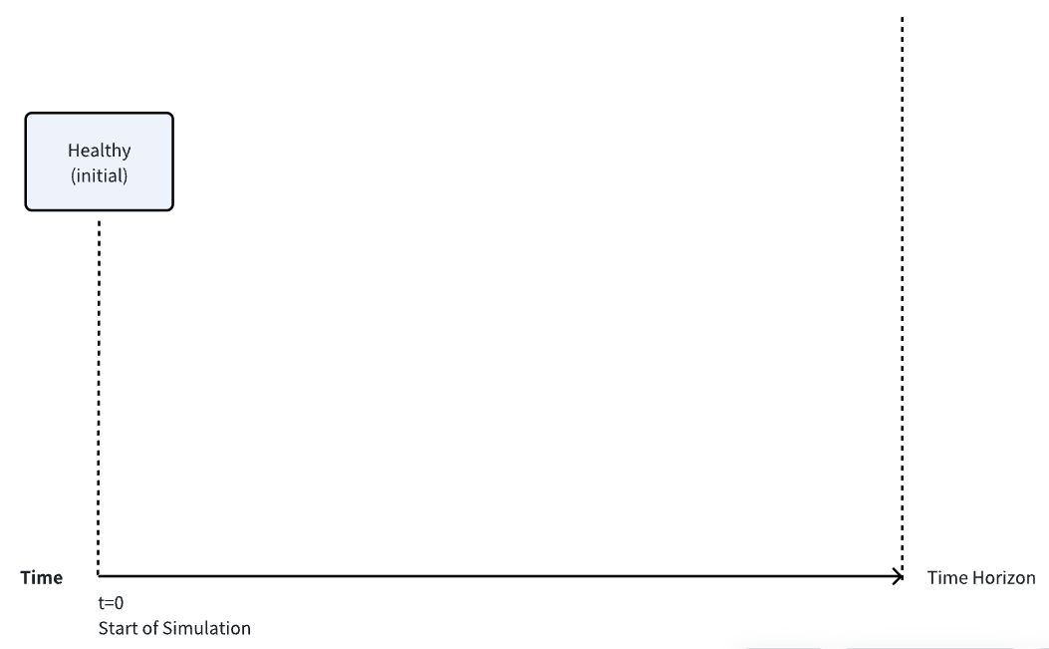

Healthy-Sick-Death Example
rHealthyDeath = 0.03
rHealthySick = 0.1
rSickDeath = 0.2
Set seed, No CRN;
In status quo, rHealthySick = 0.1.
 | RN (u) | Event type | Time (t)
1 | 0.467 | t_BGdeath | 21 yrs
2 | 0.834 | t_sick | 18 yrs
Person 1,
LE = 21 yrs
H -> S -> BGdeath
Person 1
3 | 0.926 | t_sickdeath | 13 yrs
Person 2,
LE = 30 yrs
H -> BGdeath
4 | 0.593 | t_BGdeath | 30 yrs
5 | 0.959 | t_sick | 32 yrs
6 | 0.808 | t_BGdeath | 55 yrs
7 | 0.393 | t_sick | 5 yrs
8 | 0.889 | t_sickdeath | 11 yrs
Person 3,
LE = 16 yrs
H -> S -> SickDeath
9 | 0.189 | t_BGdeath | 7 yrs
… | … |  | …
Notes:
Go back to our Healthy-Sick-Death example, assuming the usual way to do the simulation: set seed which helps to produce the same random number sequence between runs, but do not use common random numbers. For status quo, rate of getting sick from Healthy is 0.1. So we generate the random number for background death and the number for getting sick. Compare the two numbers for time, the next event is getting sick. Then generate the number for dying of the disease, so next event is background death, happening at the 21st year. The life expectation will be 21 years. For patient 2, time to background death is 30 years, lower than time to get sick. For patient 3, the time to get sick adding the time to die of the disease is 16 years, lower than time to background death. The life expectation will be 16 years.

Slide 8
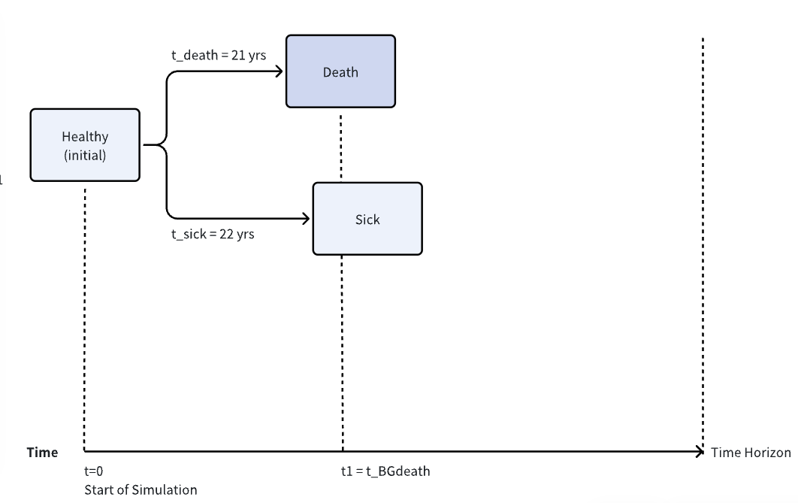
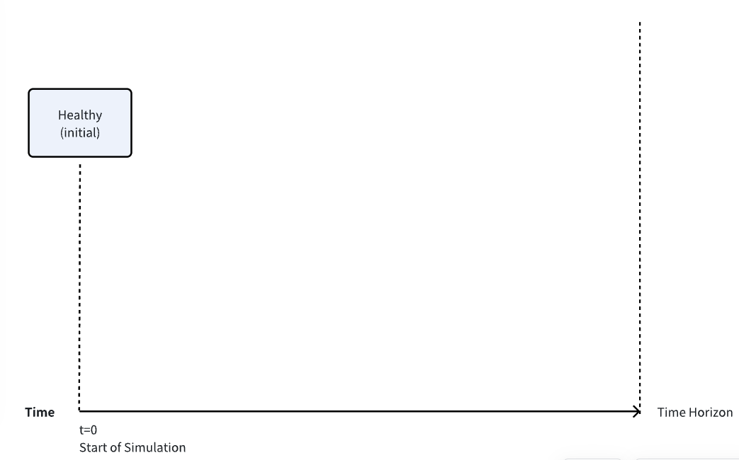
Healthy-Sick-Death Example
rHealthyDeath = 0.03
rHealthySick = 0.08
rSickDeath = 0.2
Set seed, No CRN;
An intervention reduces rHealthySick to 0.08.
 | RN (u) | Event type | Time (t)
1 | 0.467 | t_BGdeath | 21 yrs
2 | 0.834 | t_sick | 22 yrs
Person 1,
LE = 21 yrs
H -> BGdeath
The following simulated events were also impacted due to the random number misalignment.
Person 1
3 | 0.926 | t_BGdeath | 87 yrs
4 | 0.593 | t_sick | 11 yrs
5 | 0.959 | t_sickdeath | 16 yrs
Person 2,
LE = 27 yrs
H -> S -> Sickdeath
Lower incidence led to lower LE for Person 2 ->
Stochastic noise
6 | 0.808 | t_BGdeath | 55 yrs
7 | 0.393 | t_sick | 6 yrs
8 | 0.889 | t_sickdeath | 11 yrs
Person 3,
LE = 17 yrs
H -> S -> SickDeath
9 | 0.189 | t_BGdeath | 7 yrs
… | … |  | …
Notes:
assuming an intervention reduces rate of healthy to sick. With a lower incidence, we will expect a higher life expectation. For the first person, with the same u, time to sick changes to be 22 years, which led to the person going to background death directly, still at the 21st year. For next person, the following simulated events will all change. It is like the Domino effect. The numbers for him will all change. He got sick at the 11th year and die of disease at 27th year. Person 3 just get one more year when getting sick. The random number misalignment will influence the following simulated events, and for person 2, a lower incident actually led to a lower life expectation, the stochastic noise is misleading here.

Slide 9
Common Random Numbers(CRNs)
Random Numbers For each event and each person.
Person 1 (LE = 14 yrs) |  |  | Person 2 (LE = 10 yrs) |  |  | Person 3 (LE = 20 yrs) |  | … | …
t_Sick (r = 0.1) | t_BGDeath (r = 0.03) | t_SickDeath (r = 0.2) | t_Sick (r = 0.1) | t_BGDeath (r = 0.03) | t_SickDeath (r = 0.2) | t_Sick (r = 0.1) | t_BGDeath (r = 0.03) | t_SickDeath (r = 0.2) | …
0.467 (6 yrs) | 0.661 (36 yrs) | 0.805 (8 yrs) | 0.596 (9 yrs) | 0.375 (23 yrs) | 0.199 (1 yr) | 0.538 (8 yrs) | 0.305 (12 yrs) | 0.986 (21 yrs) | …
Status quo
rHS = 0.1
Person 1 (LE = 16 yrs) |  |  | Person 2 (LE = 12 yrs) |  |  | Person 3 (LE = 22 yrs) |  | … | …
t_Sick (r = 0.08) | t_BGDeath (r = 0.03) | t_SickDeath (r = 0.2) | t_Sick (r = 0.08) | t_BGDeath (r = 0.03) | t_SickDeath (r = 0.2) | t_Sick (r = 0.08) | t_BGDeath (r = 0.03) | t_SickDeath (r = 0.2) | …
0.467 (8 yrs) | 0.661 (36 yrs) | 0.805 (8 yrs) | 0.596 (11 yrs) | 0.375 (23 yrs) | 0.199 (1 yr) | 0.538 (10 yrs) | 0.305 (12 yrs) | 0.986 (21 yrs) | …
Intervention
rHS = 0.08
A lower incidence leads to an improved life expectancy.
Notes:
But if we apply common random numbers here and distribute the random number for each event and each person, the lower incidence will only lead to an improved life expectation.

Slide 10
Common Random Numbers(CRNs)
Pros
Cons
Fewer trajectories
to converge
Programming complexity
Reduces
stochastic noises
Helps
sensitivity analysis
RN generator
computational time
Notes:
Here we see common random numbers reduce stochastic noises, which will lead to fewer trajectories to converge totally and also help with sensitivity analysis. On the other side, it will also make programming more complicated. Also, as we need to generate all the random numbers for all possible events and people ahead of time, this may take some time to compute.

Slide 11
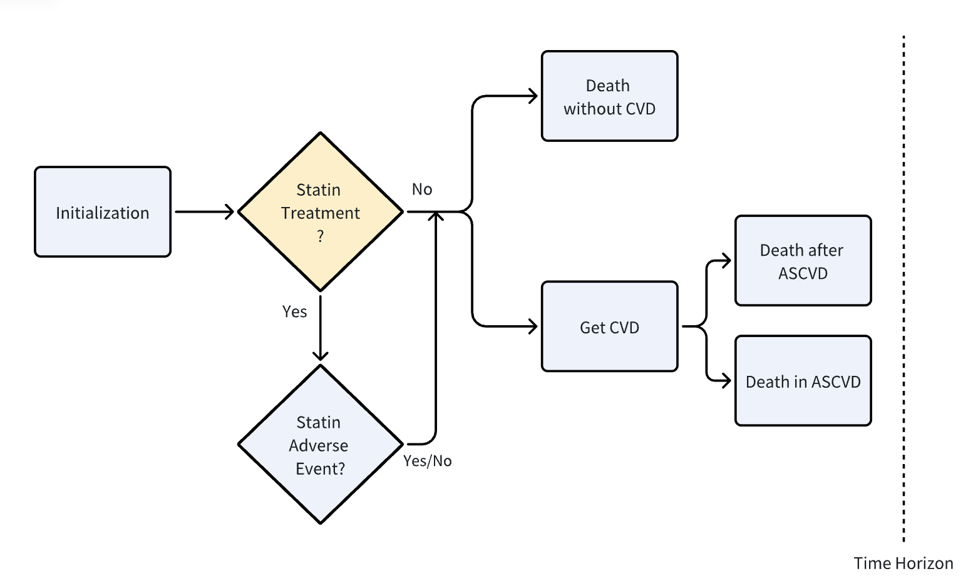
Case Study: Statin Treatment
Cohort: US people aged 40~80 at risk of atherosclerotic cardiovascular disease (ASCVD), populated with the National Health and Nutrition Examination Survey.
Parameterization: Spahillari A., etc. JAMA Cardiol (2020)
Strategy: Statins vs. No Treatment
Outcome: Net Health Benefit (NHB)
Model Schematic
Notes:
Let’s see a case study for the net health benefit of using statins to reduce the risk of ASCVD in US population based on NHANES.

Slide 12
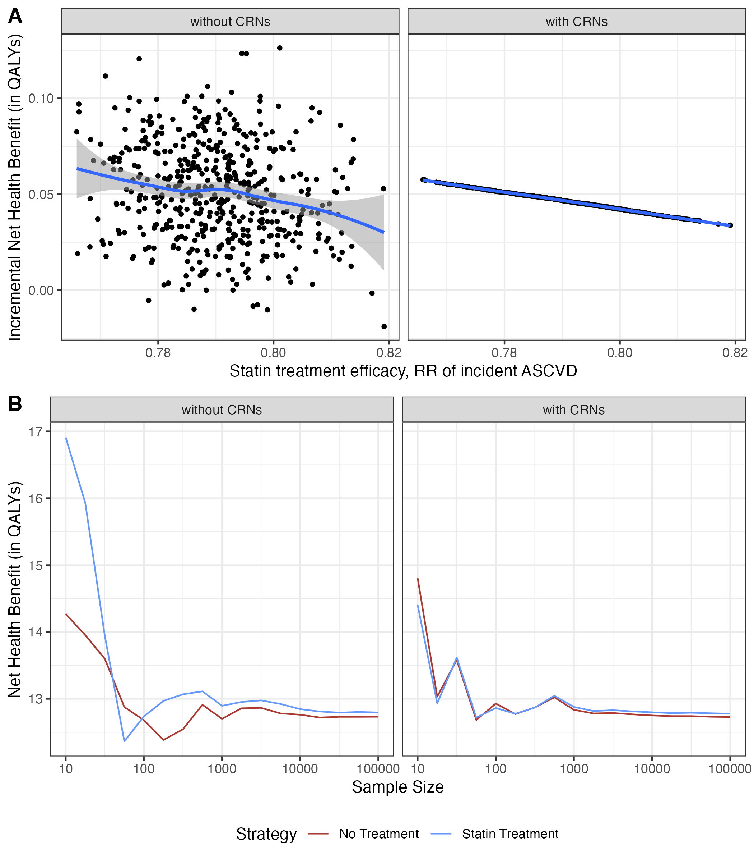
Effect of CRNs on Model Outputs
One-way sensitivity analysis for the relative risk of ASCVD for statin use:
CRN reduced the stochastic noise.
Notes:
When we are doing the one-way sensitivity analysis for the relative risk of ASCVD, a higher relative risk should lead to a lower incremental net health benefit between statins versus no treatment. The blue line is the smooth trend line and the ribbon is the 95% confidence interval. Using common random numbers significantly reduces the noise from the scatter plot.

Slide 13
Effect of CRNs on Model Outputs
Faster stabilization of the estimated iNHB around the true value with smaller sample sizes
Notes:
On the other hand, when comparing the two strategies, the x-axis here is the sample size we used for simulation. common random numbers also contribute to faster stabilization of result around the true value with a smaller sample size.

Slide 14
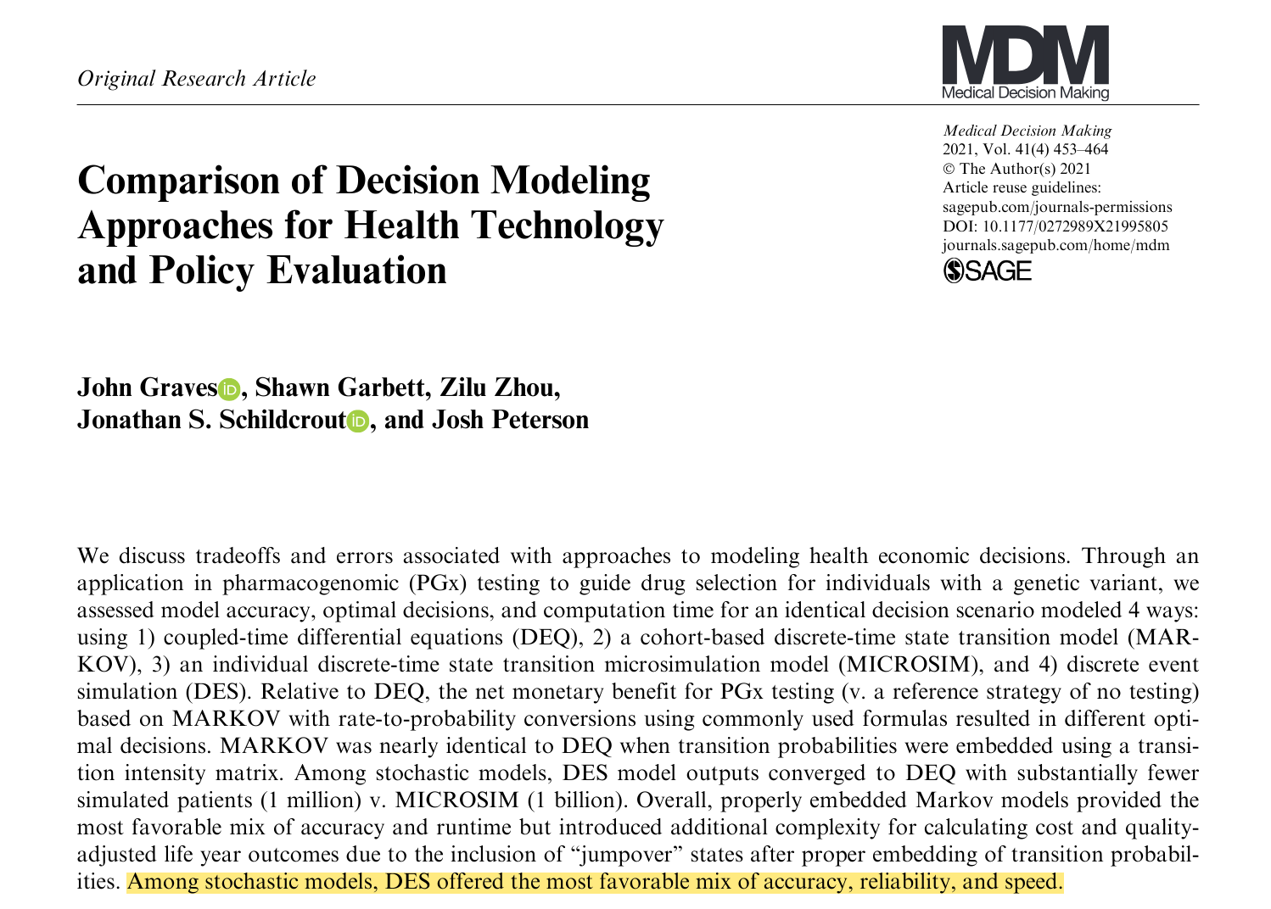
Notes:
One of my mentor, John Graves published a paper indicating DES is more efficient and accurate than other simulation models.

Slide 15
Conclusions
Reduce the noise around the true value
Enhance efficiency in computationally intensive tasks
Probabilistic sensitivity analysis, model calibration, and value of information analysis…
Notes:
And common random number can make it even better. We’ll need it in lots of computational-intensive tasks.

Slide 16
Thank you!
Email: hanxuan.a.yu@vumc.org
Twitter: @hanxuan_yu

